Slide 1


School of Computing and Information Technology, Eastern International University (EIU) - Vietnam

Slide 2





School of Computing and Information Technology, Eastern International University (EIU) - Vietnam

Slide 3

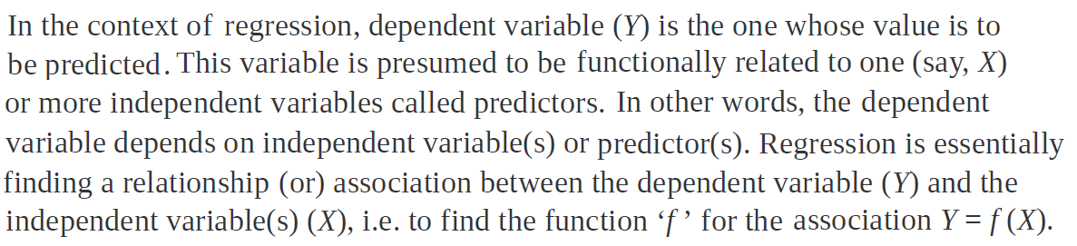
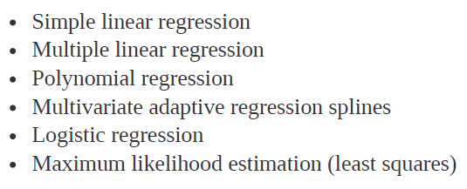
School of Computing and Information Technology, Eastern International University (EIU) - Vietnam

Slide 4

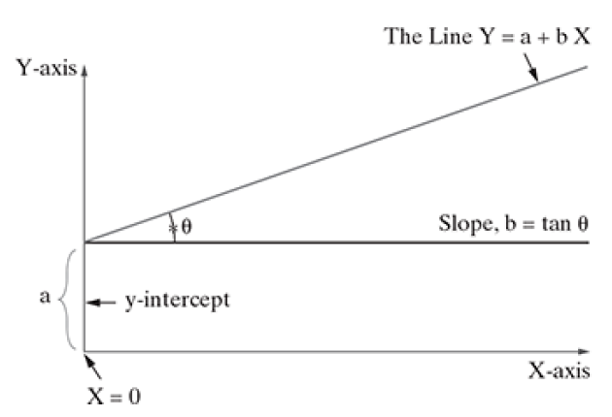
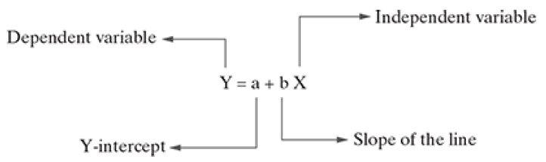

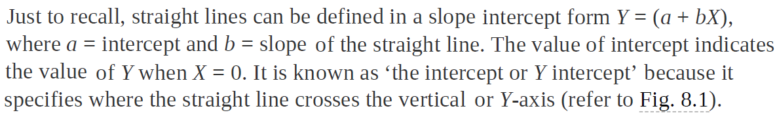

Slide 5
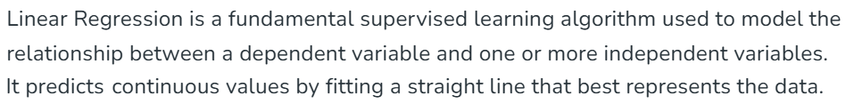
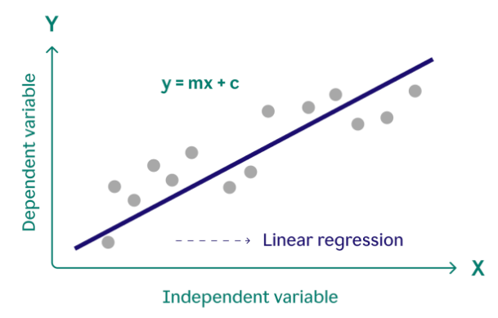
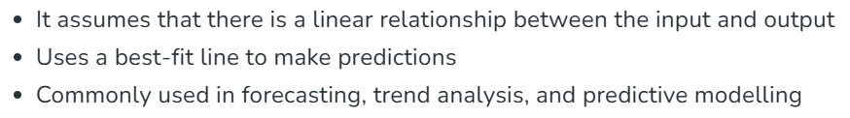
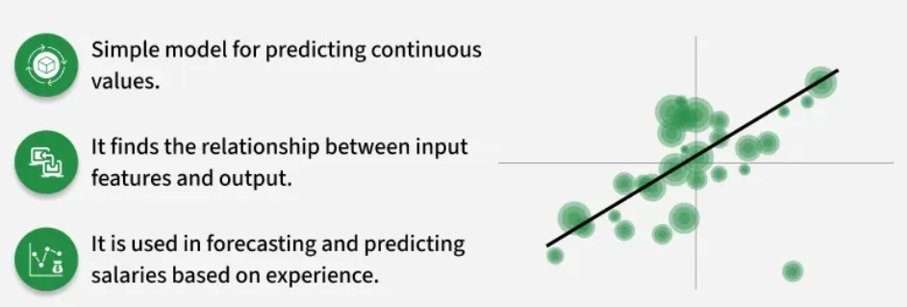
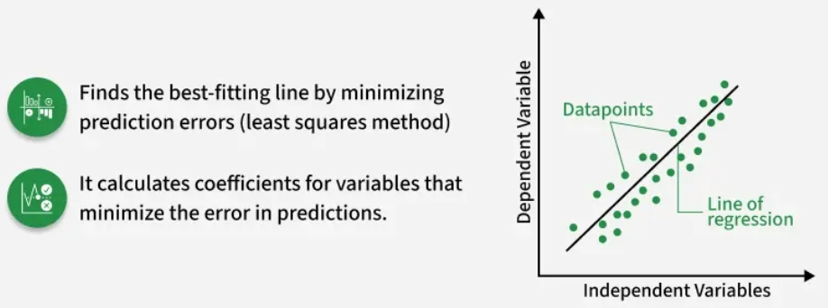

Slide 6
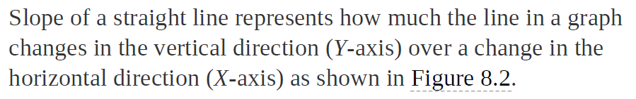
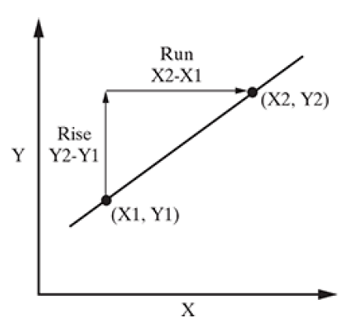




School of Computing and Information Technology, Eastern International University (EIU) - Vietnam

Slide 7
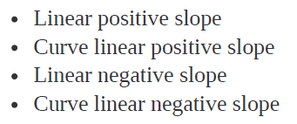
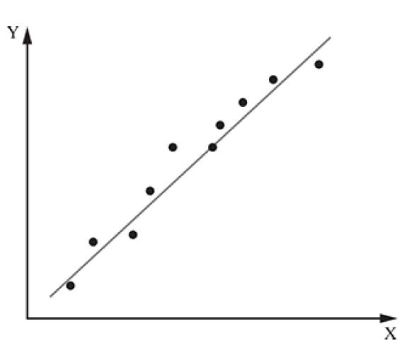

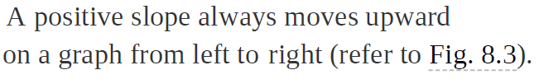
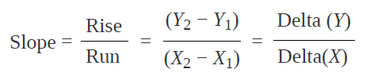


School of Computing and Information Technology, Eastern International University (EIU) - Vietnam

Slide 8

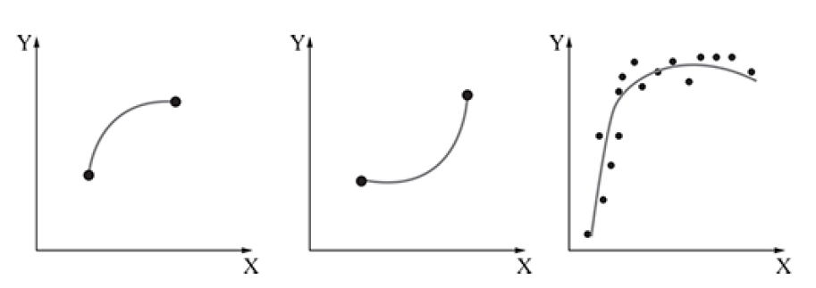

School of Computing and Information Technology, Eastern International University (EIU) - Vietnam

Slide 9
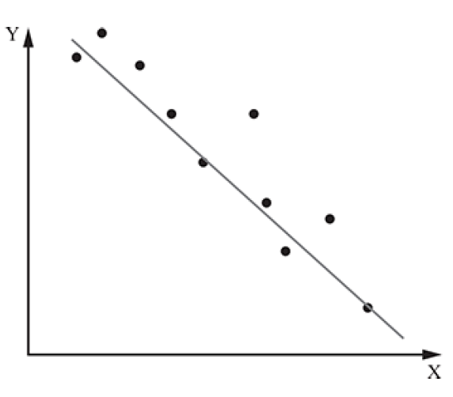



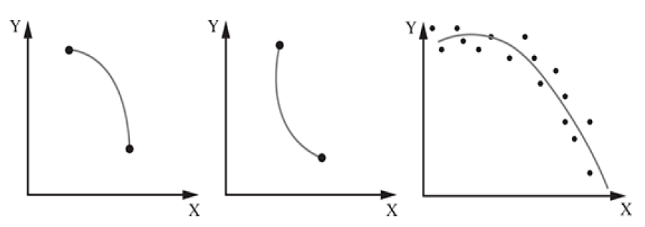




Slide 10

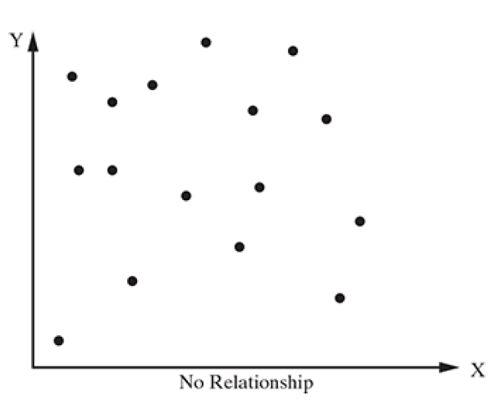
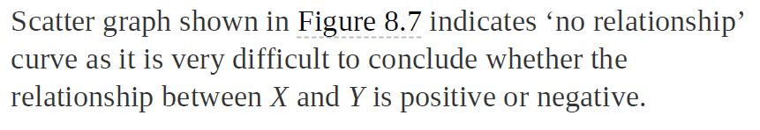


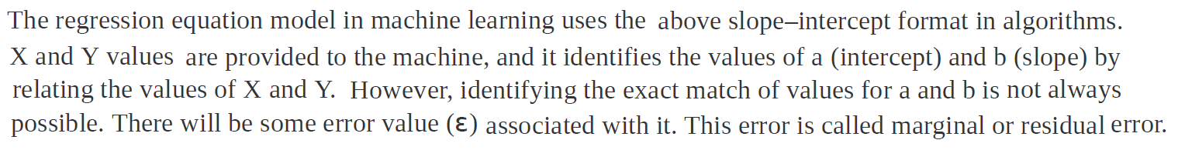


Slide 11
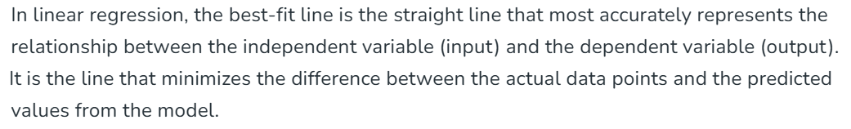
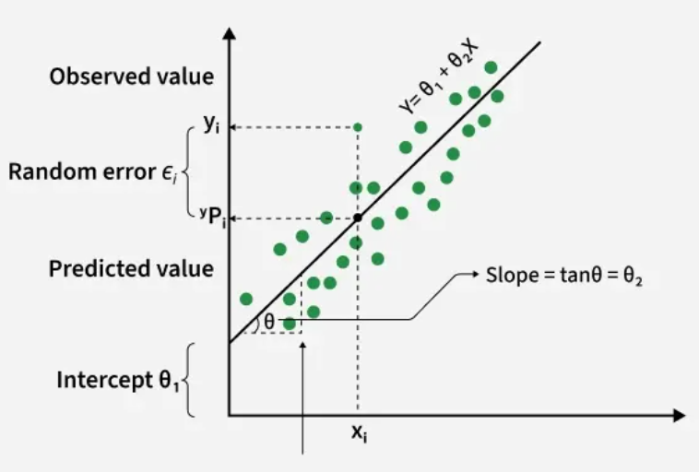

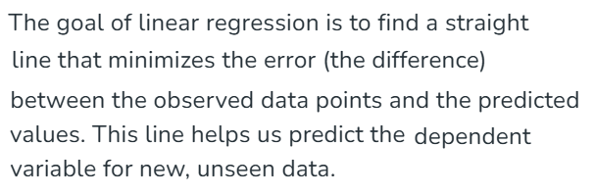
School of Computing and Information Technology, Eastern International University (EIU) - Vietnam

Slide 12


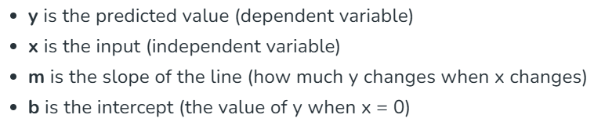


Slide 13
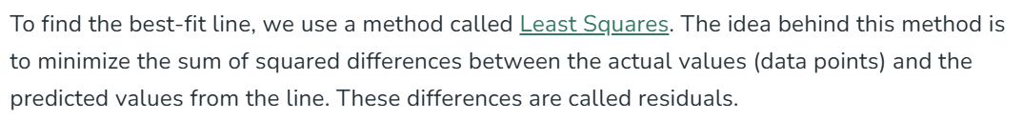




School of Computing and Information Technology, Eastern International University (EIU) - Vietnam

Slide 14

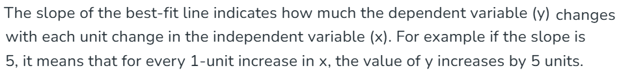


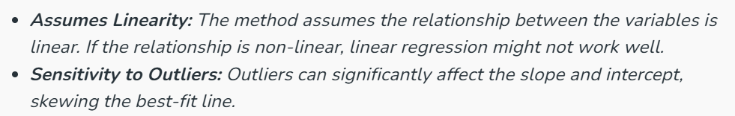

School of Computing and Information Technology, Eastern International University (EIU) - Vietnam

Slide 15
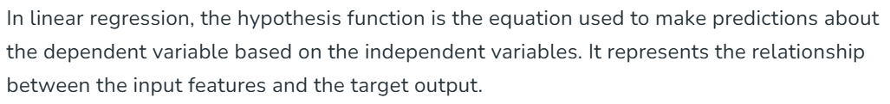

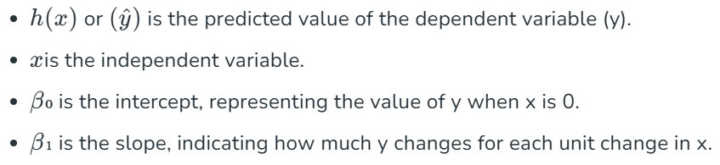
School of Computing and Information Technology, Eastern International University (EIU) - Vietnam

Slide 16
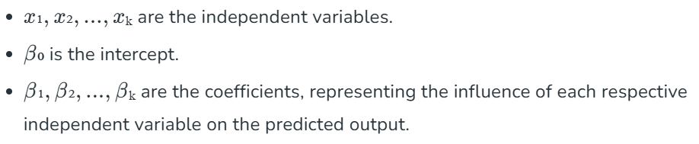
School of Computing and Information Technology, Eastern International University (EIU) - Vietnam

Slide 17
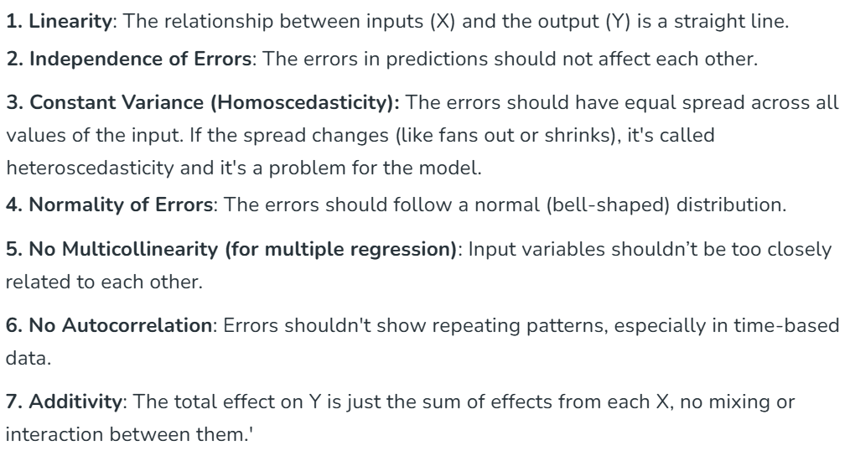
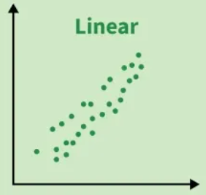
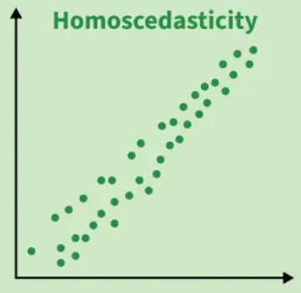
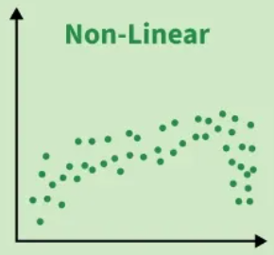

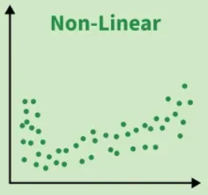

Slide 18

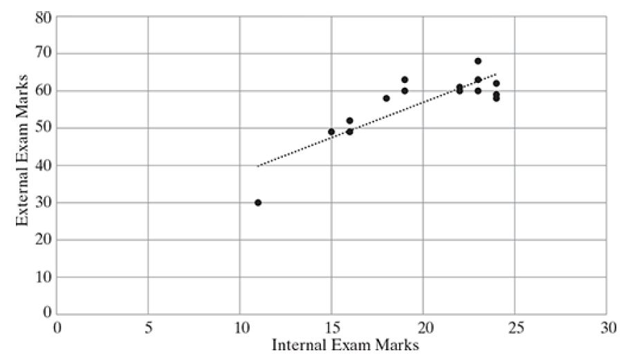
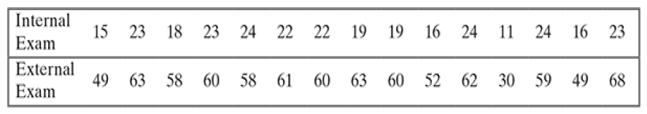
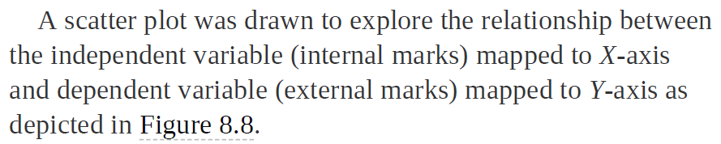
School of Computing and Information Technology, Eastern International University (EIU) - Vietnam

Slide 19
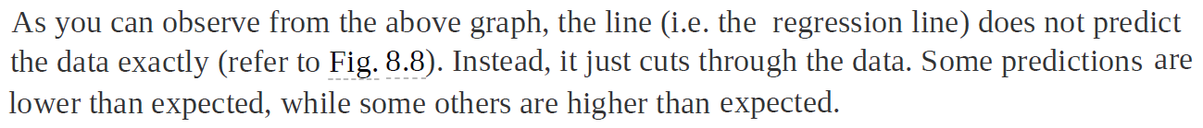
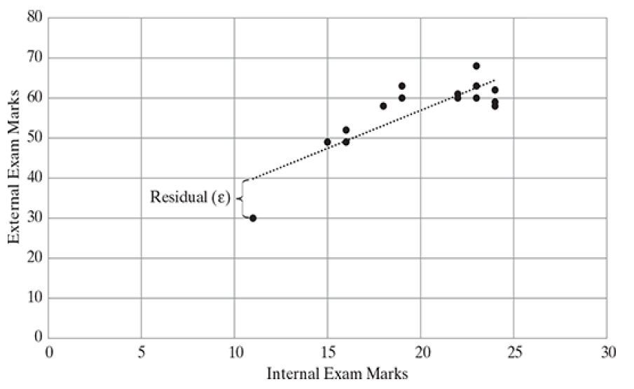
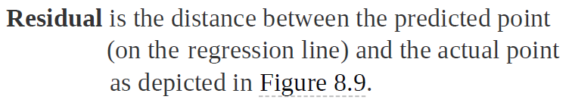


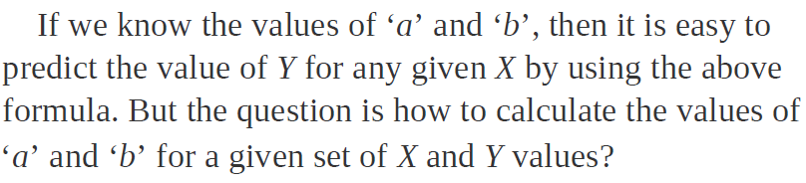


Slide 20
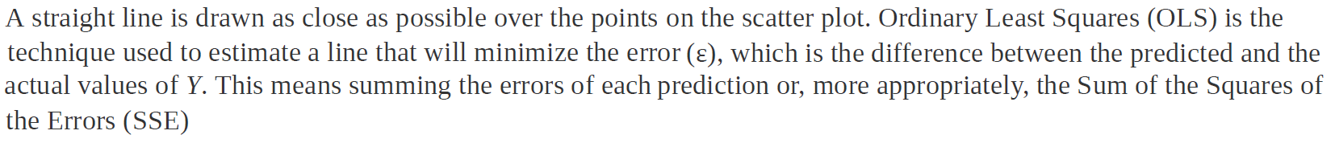
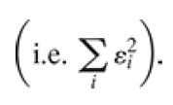
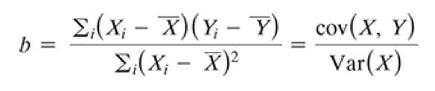

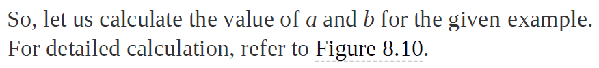
School of Computing and Information Technology, Eastern International University (EIU) - Vietnam

Slide 21

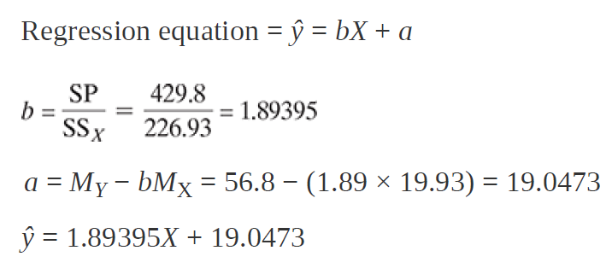
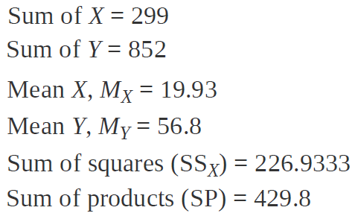


School of Computing and Information Technology, Eastern International University (EIU) - Vietnam

Slide 22


School of Computing and Information Technology, Eastern International University (EIU) - Vietnam

Slide 23






School of Computing and Information Technology, Eastern International University (EIU) - Vietnam

Slide 24



School of Computing and Information Technology, Eastern International University (EIU) - Vietnam

Slide 25




School of Computing and Information Technology, Eastern International University (EIU) - Vietnam

Slide 26







School of Computing and Information Technology, Eastern International University (EIU) - Vietnam

Slide 27



School of Computing and Information Technology, Eastern International University (EIU) - Vietnam

Slide 28





Slide 29

School of Computing and Information Technology, Eastern International University (EIU) - Vietnam

Slide 30


Slide 31




School of Computing and Information Technology, Eastern International University (EIU) - Vietnam

Slide 32


School of Computing and Information Technology, Eastern International University (EIU) - Vietnam

Slide 33



School of Computing and Information Technology, Eastern International University (EIU) - Vietnam

Slide 34





School of Computing and Information Technology, Eastern International University (EIU) - Vietnam

Slide 35


Slide 36

School of Computing and Information Technology, Eastern International University (EIU) - Vietnam

Slide 37




School of Computing and Information Technology, Eastern International University (EIU) - Vietnam

Slide 38


School of Computing and Information Technology, Eastern International University (EIU) - Vietnam

Slide 39





School of Computing and Information Technology, Eastern International University (EIU) - Vietnam

Slide 40








Slide 41






Slide 42


School of Computing and Information Technology, Eastern International University (EIU) - Vietnam

Slide 43

School of Computing and Information Technology, Eastern International University (EIU) - Vietnam

Slide 44

School of Computing and Information Technology, Eastern International University (EIU) - Vietnam

Slide 45

School of Computing and Information Technology, Eastern International University (EIU) - Vietnam

Slide 46



